Slide 1

Planning For Peace of Mind: Advance Care Planning
We will begin at 12:35 PM
Thank you for your patience ☺
Please type your questions in the Q & A box or ask them at the end of both presentations.
This presentation contains information which some participants may be sensitive to and/ or find triggering.

Slide 2
Planning for Peace of Mind: A Workshop on Advance Care Planning, Sooner Rather Than Later, #April16 April 13, 2026
Alyssa Steele, LCSW, OSW-C
Nina Raymond, LCSW
Rose Slirzewski, LCSW
Nicole Woo, LCSW
Licensed Clinical Social Workers
Arlene Cruz, APN, AGNP-PC, OCN
Advanced Practice Provider

Slide 3
What is Advance Care Planning (ACP)?
Anything you do that helps you, your family, friends and medical team know about the care you want to receive, including but not limited to:
Getting information on the types of treatments available; your care options
Deciding what types of treatment you would or would not want to receive
Sharing your personal values with your loved ones; especially what quality of life means to you.
Completing advance directives to put into writing what treatment options you would and/or would not want, should you be unable to speak for yourself
Source: www.nhpco.org

Slide 4
Did You Know…
The 1990 Patient Self-Determination Act encourages everyone to decide ahead of time about the extent and types of medical care they want to accept and/or refuse in the event they are unable to make these decisions due to illness. It also requires healthcare providers to ask if you have an advance directive.
A survey, conducted by the Conversation Project, reported that more than 9 in 10 Americans think it is important to discuss their wishes for end-of-life care. However only 3 in 10 have actually had these discussions.
A review of 150 studies with nearly 800,000 participants showed 36.7% had an advance directive (29.35 were living wills). Proportions of patients with chronic illnesses (38.2 percent) and healthy adults (32.7 percent) who had completed advance directives were similar. *
Experts recommend hospitalists (dedicated in-patient physicians who work exclusively in hospitals) engage in ACP with all patients 65 years or older, instead of screening for those with serious illness.**
April 16 is recognized each year as National Health Care Decisions Day
* Source: Yadav, K. N., Gabler, N. B., Cooney, E. et al. Approximately One In Three US Adults Completes Any Type Of Advance Directive For End-Of-Life Care https://www.healthaffairs.org/journal/hlthaff
** Source: Mohan, D., Sacks, O.A., O’Malley, J. et al. A New Standard for Advance Care Planning (ACP) Conversations in the Hospital:Results from a Delphi Panel. J GEN INTERN MED 36, 69–76 (2021). https://doi.org/10.1007/s11606-020-06150-0

Slide 5
Did You Know…
You don’t need a lawyer to complete an advanced directive. It can be witnessed by two adults who are not your healthcare proxy.
Is your spouse your healthcare proxy? If you become divorced or legally separately, this will be revoked. If not legally separated, the proxy remains as is. If not legally married, your partner, no matter how long you have been together, is not automatically your healthcare proxy.
Haven’t decided on a healthcare proxy? The priority order of persons who would be asked to make decisions for you, if you could not speak on your own behalf are:
1. spouse, partner in a civil union couple, or domestic partner, if not legally separated
2. child, age 18 or older
3. parent
4. sibling, age 18 or older
5. close friend
Advance care planning is about what treatment and care you would and would not want .… these are equally important.
April 16th is National Healthcare Decision Day

Slide 6
Did You Know…
Who you choose as your healthcare proxy is important. Your proxy needs to be able to act on your wishes. That may or may not be the person with whom you are closest.
If you choose someone other than the expected person (spouse, partner or sibling for example), make sure everyone is aware of your decision.
When you choose an unexpected person, it can be difficult to communicate. Just be honest, clear and keep it simple.

Slide 7
How Do I Begin The Conversations With My Family?
“I need your help with something.”
“I was thinking about what happened to _____ and it made me realize…”
“Even though I’m okay right now, I’m worried that…..and I want to be prepared.”
“I need to think about the future. Will you help me?”
“I just answered some questions about how I want the end of my life to be. I want you to see my answers. And I’m wondering what your answers would be.”
Sources: www.ihi.org and www.theconvesationproject.org

Slide 8
How Do I Prepare For My Advance Care Planning?
Things to think about:
How do I get more information about my treatment options?
What would I want people to know so that they could honor what I want and don’t want?
Who would I want to share this with?
How would I want to share this?
Next steps:
Start small-write down three things you want your doctor, family and friends to know about how you would like the end of your life to be.
Prepare questions for your doctor.
Think about roadblocks, push back and potential disagreements between those closest to you.
Source: www.nhpco.org

Slide 9
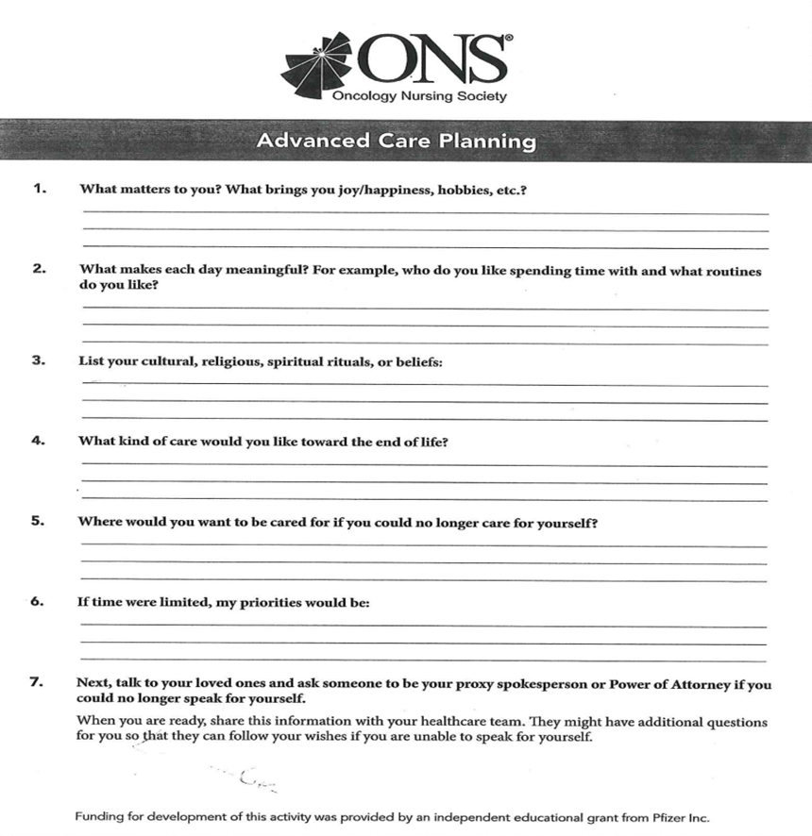

Slide 10
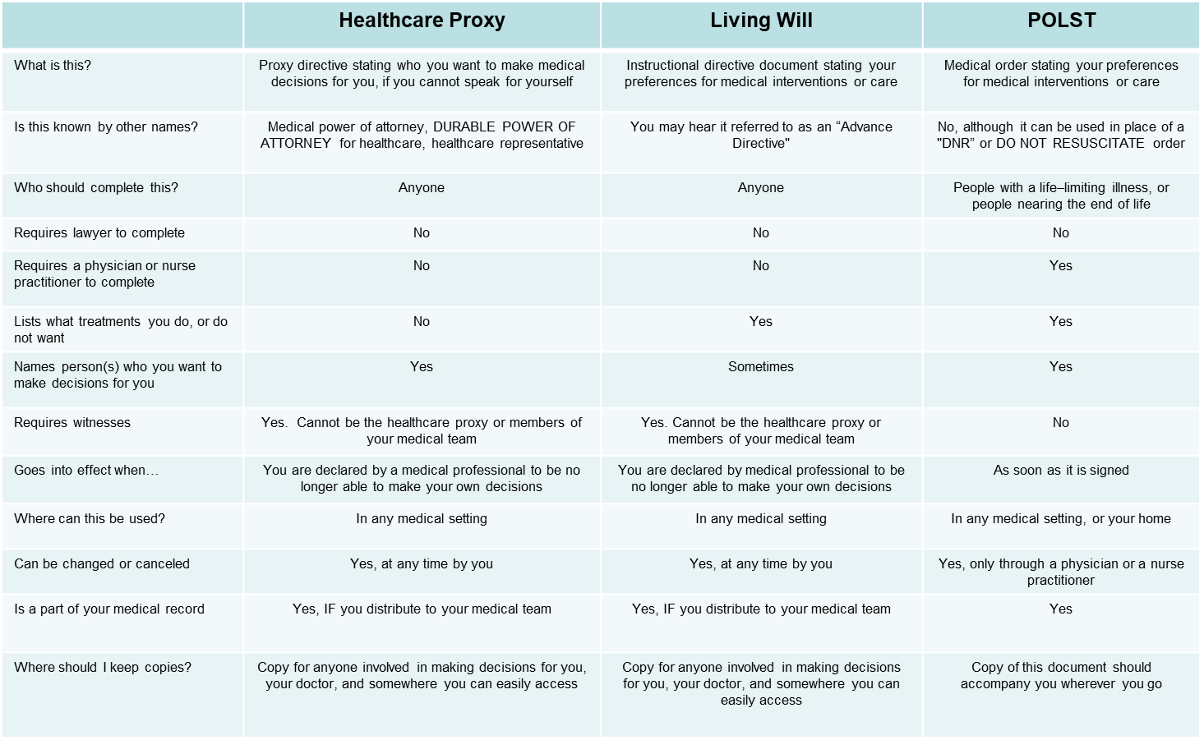

Comparison Chart: Advance Directives

Slide 11
New Jersey Advance Directives
Proxy Directive (Durable Power of Attorney for Health Care)
Instructive Directive (Living Will)
https://www.state.nj.us/health/advancedirective/documents/proxy_directive.pdf
On this form you choose who will make decisions for your medical care when you are not able to do so.
On this form you decide if your representative can make a decision about artificial fluids or nutrition.
You can list two alternate people if you wish.
A notary is not required.
Two witnesses are required; they cannot be individuals designated as healthcare proxies on this form.
https://www.state.nj.us/health/advancedirective/documents/instruction_directive.pdf
This document gives specific information about your wishes for your end-of-life care.
It clarifies wishes that all life sustaining treatment is to continue vs options for ending some or all treatments.
Included are sections that give more specific instructions for CPR, artificial fluids/nutrition, brain death, and body donation.
This document does not require a notary.

Slide 12
Definitions:
What is the definition of "life-sustaining treatment"? Life sustaining treatment is any medical device or procedure that increases your life expectancy by restoring or taking over a vital bodily function. The medical device or procedure can be a drug, ventilator (breathing machine), surgery, therapy or artificially provided fluids and nutrition.
What is the definition of “permanently unconscious"? Permanently unconscious means you have permanently lost the ability to interact with your environment and are completely unaware of your surroundings.
What is the definition of "terminal condition"? Terminal condition means the final stage of a fatal illness, disease or condition. To be in a terminal condition you do not have to be diagnosed as having less than a certain amount of time to live.

Slide 13
Frequently Asked Questions:
Can my Proxy make decisions for me if I am still able to make my own decisions?
No, your Proxy can only make decisions for you if your physician has evaluated you and determined you are unable to understand your diagnosis, treatment options or the possible benefits and harms of the treatment options.
What happens if I regain the ability to make my own decisions?
In that case, your physician must obtain your consent for all treatment. Once you have the ability to make healthcare decisions your healthcare representative will no longer have the authority to make decisions for you.
Who should have a copy of my advance directive?
You should give a copy to your primary healthcare representative, alternate healthcare representative(s), family members and physicians. If you are treated at a hospital or enter a nursing home, you should also provide a copy when you are admitted.
Can I change my advance directive?
Yes, you can change your advance directive any time you want by completing a new one. You need to sign and date your new advance directive and have two witnesses sign and date it.
Can I cancel my advance directive?
Yes, you can cancel your advance directive any time you want. To cancel it you need to tell your physician, family, healthcare representative, nurse, social worker or a reliable witness that you want to cancel your advance directive. You can tell them verbally or send them a letter.

Slide 14

Sample Advance Directive

Slide 15
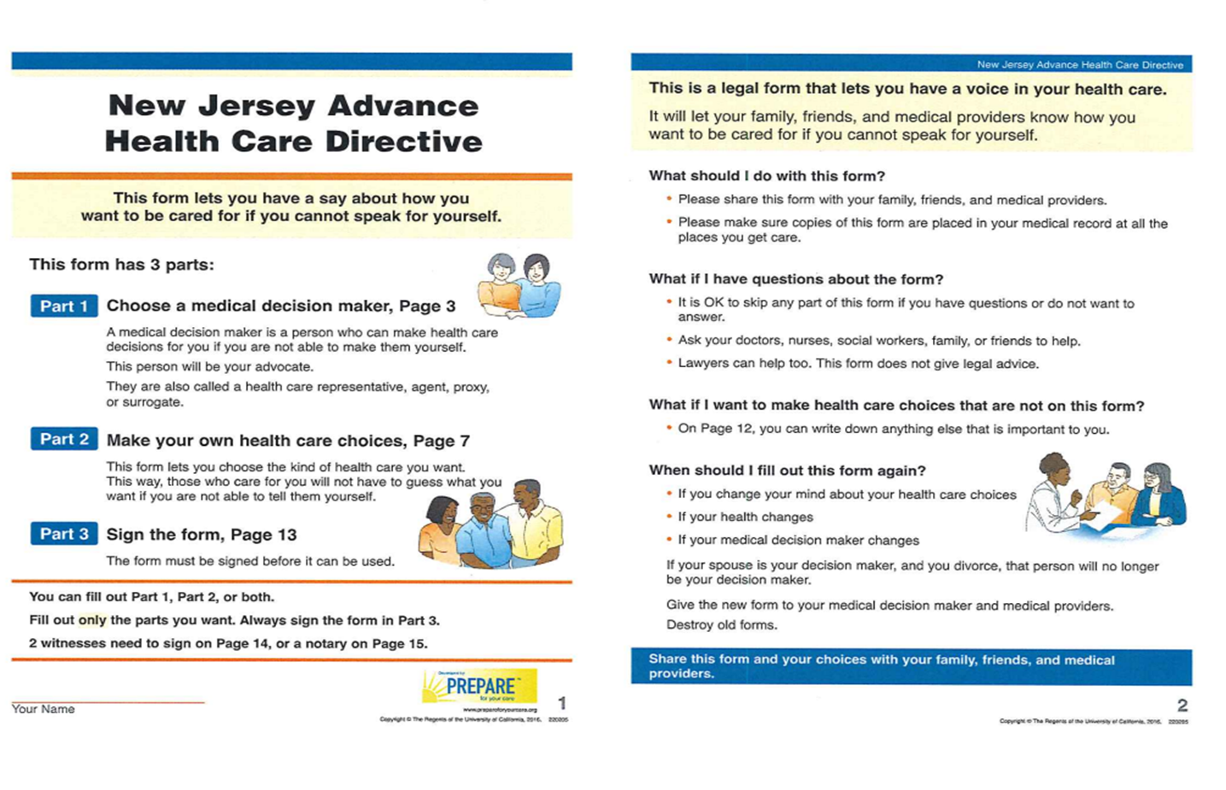

Slide 16
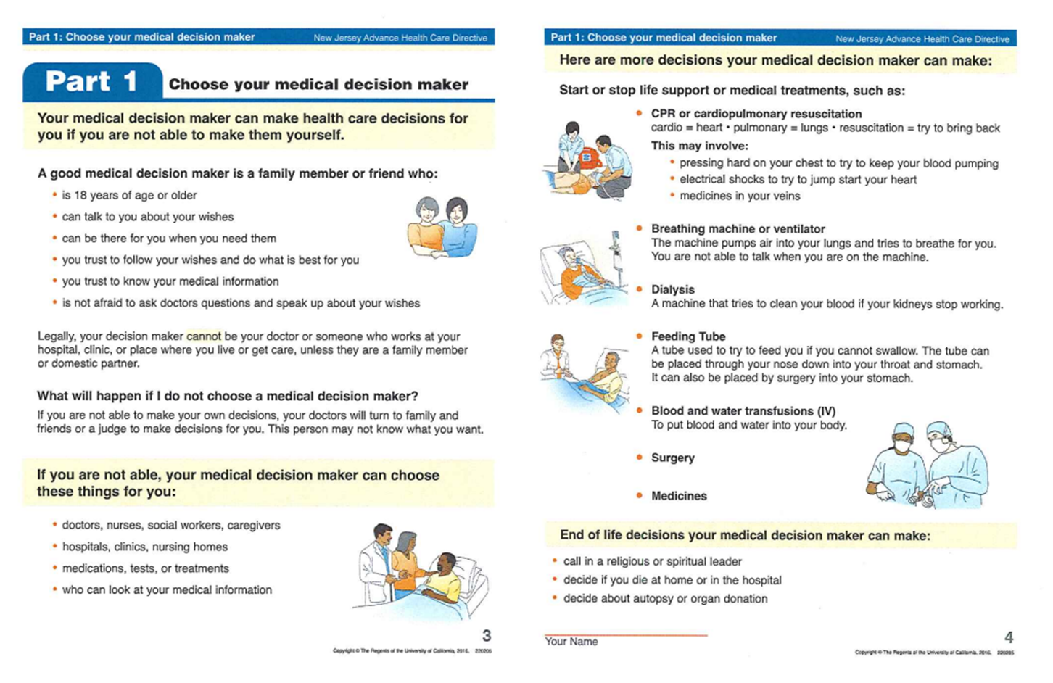

Slide 17
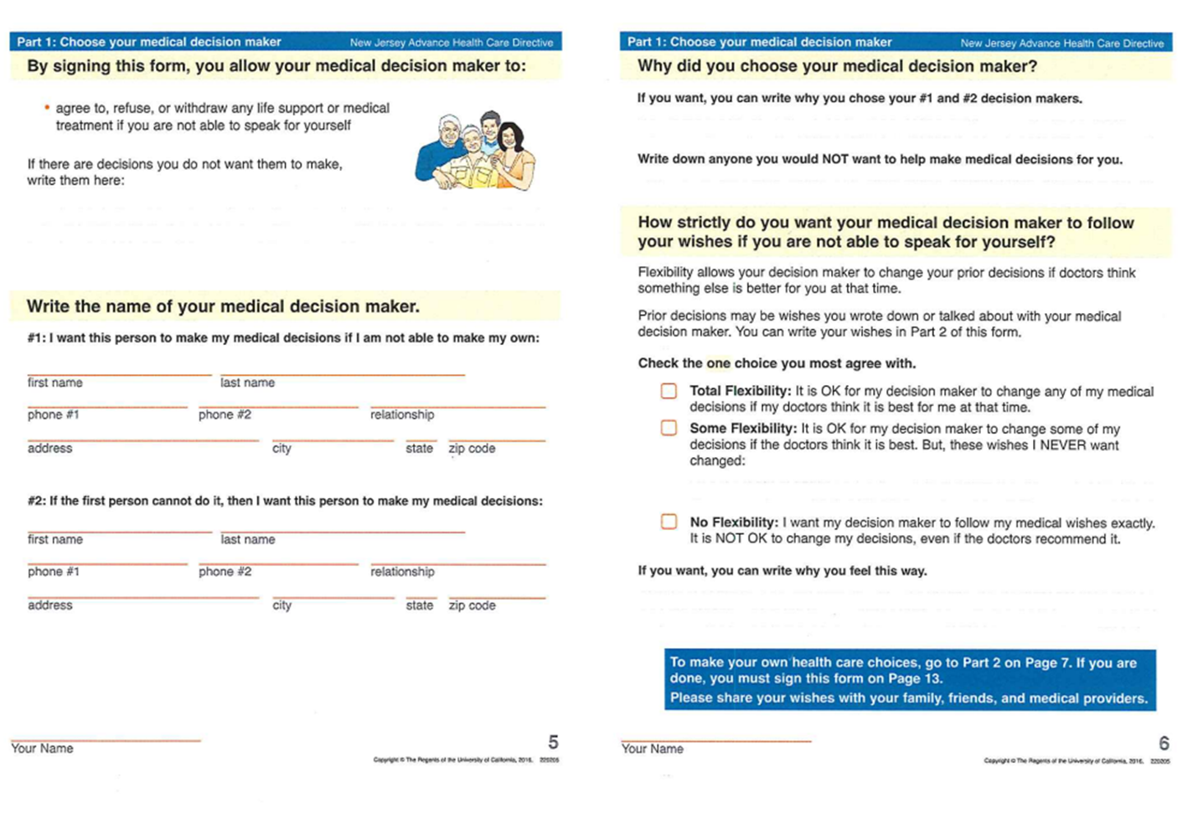

Slide 18
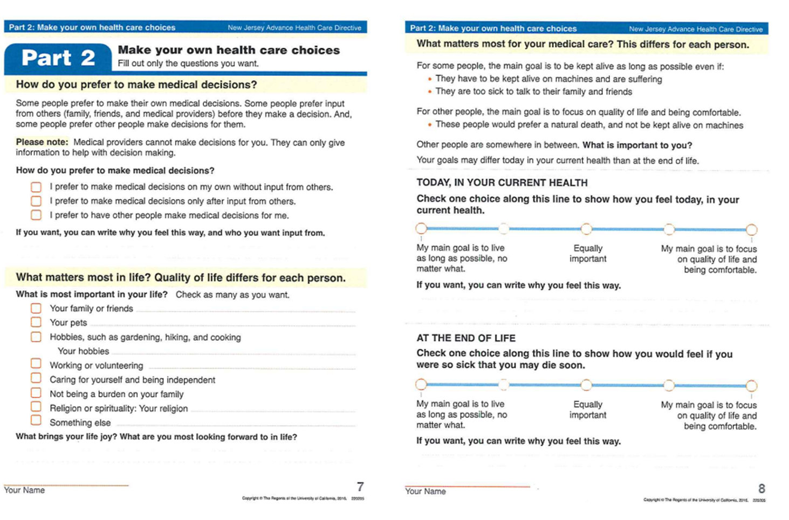

Slide 19
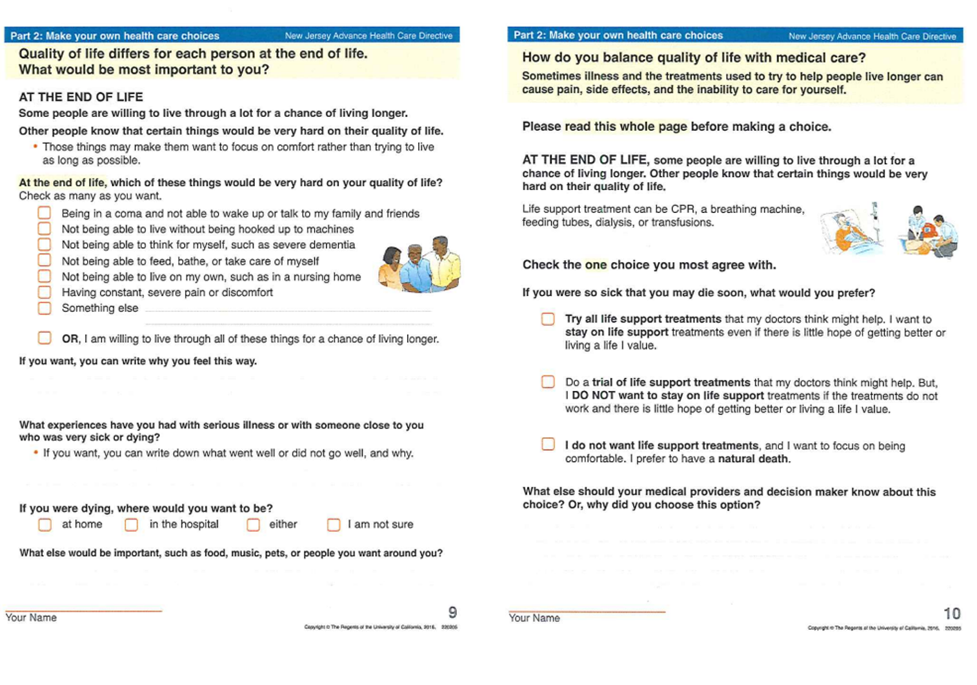

Slide 20
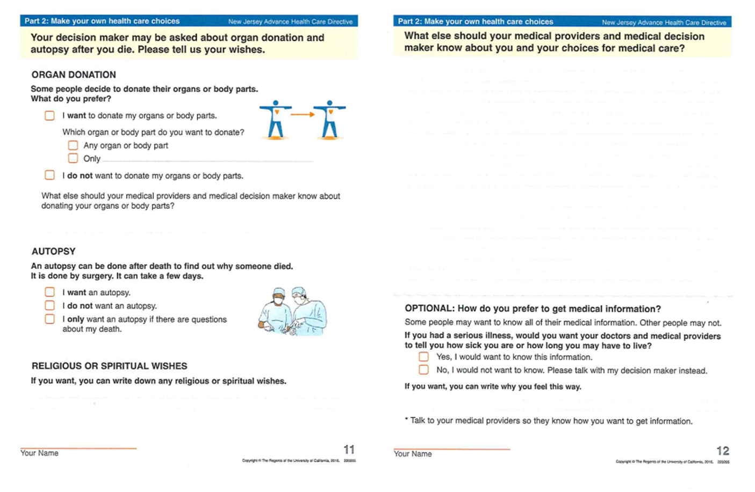

Slide 21
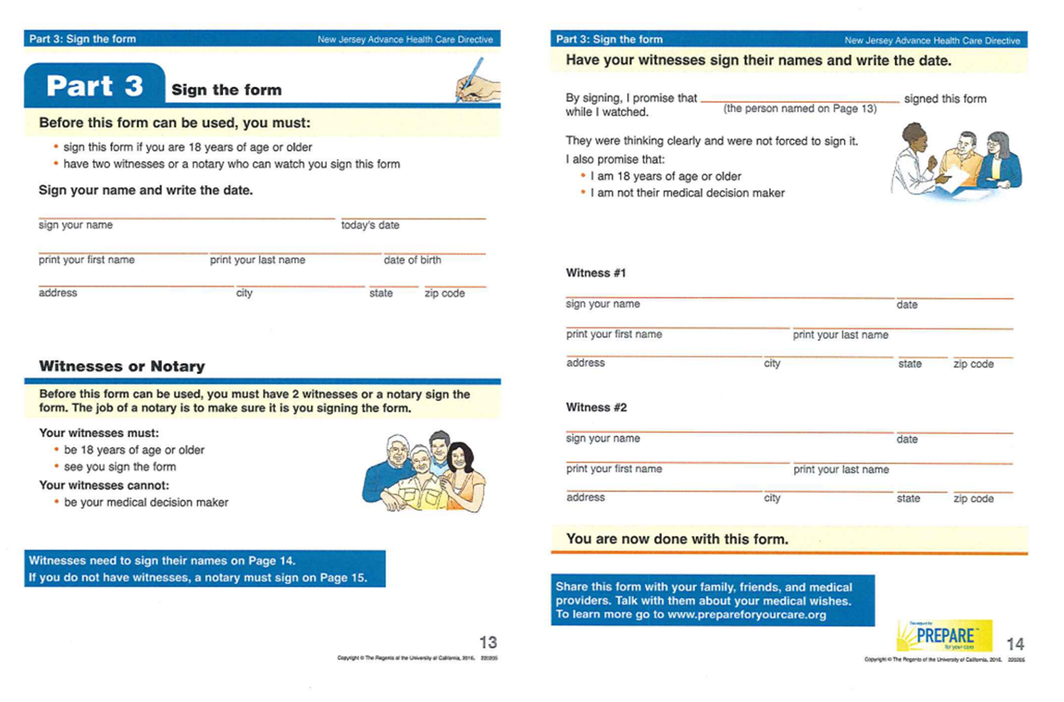

Slide 22
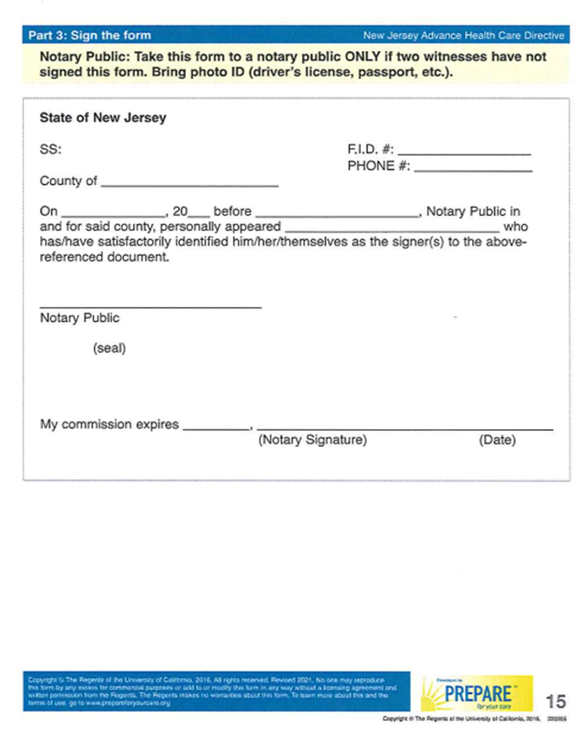
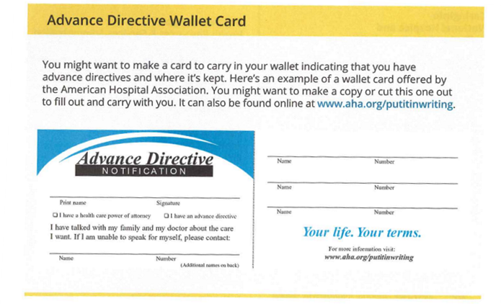
Wallet Card

Slide 23
NJ Medical Aid in Dying for the Terminally Ill Act
The NJ Medical Aid in Dying (MAID) for the Terminally Ill Act was signed into law April 12, 2019 and became effective August 1, 2019.
New Jersey was the 8th state to enact a Death with Dignity statute, following Oregon (1997), Washington (2008), Montana (2009), Vermont (2013), California (2015), Colorado (2016), and Hawaii (2018).
Currently, there are 13 states and the District of Columbia where Death with Dignity is legal and 14 states are considering Death with Dignity this year.
In 2024, British lawmakers advanced similar bills to legalize assisted dying in England and Wales; if passed, it will total 20 countries and jurisdictions around the world where MAID is legal.

Slide 24
MAID cont.
MAID allows an adult, New Jersey resident, who has the capacity to make health care decisions, who has been determined by that individual’s attending physician and a consulting physician to be terminally ill, and with a prognosis of 6 months or less to live, to obtain medication that the patient may self-administer to end their life.
A request for medication must be made 2x verbally and 1x in writing with specific time parameters in between each request and requiring witnesses to attest that the patient is capable of making their own decisions and acting voluntarily. This series of steps ensures a patient’s decision to end their life meets ethical and legal requirements.
MAID is a patient-centered process that offers terminally ill patient’s autonomy and control over their end-of-life health care options and avoid prolonged suffering.
For a terminally ill patient, making decisions on how their final days are spent is often the most challenging choice they will ever face. Family and caregiver relationships introduce another layer of complexity.
Researchers have found that involving loved ones in the planning process for MAID and allowing the loss to serve as a meaningful ritual or ceremony can be helpful. The more a family can participate in Advanced Care Planning the better.

Slide 25
Finding a Provider for MAID Services
Academy of Aid-in-Dying Medicine
www.AADM.org
Top Toolbar: “For Patients and Families”
Dropdown: “Find a Provider”
Complete the intake form at the bottom of that page
After submitting your intake form, it will take 48-72 hours to process and you will receive an email follow-up.
Once all necessary information is collected, the patient’s intake form will be forwarded directly to a provider. The provider will then contact the patient directly. Provider’s contact information is not publicly shared.

Slide 26
Resources
https://theconversationproject.org/
https://www.acpdecisions.org/
https://agingwithdignity.org/
https://www.cancer.net/sites/cancer.net/files/advanced_cancer_care_planning.pdf
http://www.begintheconversation.org/
https://prepareforyourcare.org/en/welcome
https://www.nj.gov/health/advancedirective/ad/forums-faqs/
https://www.cancer.org/cancer/managing-cancer/making-treatment-decisions/advance-directives/setting-up-a-good-adv-health-care-directive.html
https://mydirectives.com/
https://codaalliance.org/
https://www.caringinfo.org/
https://www.nia.nih.gov/health/advance-care-planning-advance-directives-health-care
https://www.nj.gov/health/advancedirective/maid/
https://deathwithdignity.org/
https://www.apa.org/monitor/2025/07-08/compassion-medical-aid-dying
https://www.AADM.org

Slide 27
Practitioner Orders for Life-Sustaining Treatment (POLST)
Arlene Cruz, APN, AGNP-PC, OCN
Jack & Sheryl Morris Cancer Center, Rutgers Cancer Institute

Slide 28

What Does “POLST” Mean?
Notes:
Practitioner Orders for Life-Sustaining Treatment

Slide 29

POLST
Healthcare planning tool that allow individuals to take charge of their health, by working with their medical providers to discuss their personal goals and medical preferences when facing advanced illness.

Slide 30
Differences Between Advance Directive And POLST
Advance Directives (AD) are statements of patient intention and POLST is a medical order.
AD are initiated/activated after a patient has been determined to have lost decision-making (DM) capacity.
Statements of AD are interpreted by healthcare providers into medical orders to become active.
AD are appropriate for anyone over 18.
Notes:
unable to make decisions- Unconscious, sedated, delirious, have psychosis...etc

Slide 31
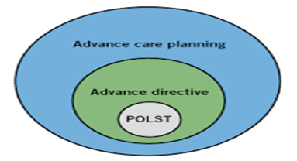
Differences
POLST is appropriate for anyone with an advanced illness.
POLST as a set of medical orders are immediately actionable-no interpretation needed.
POLST complements an AD and does not totally replace it.
Can be generated by a Physician, Advanced Practice Nurse (APN), or Physician Assistant (PA) with the patient or surrogate (if patient does not have decision making capacity).

Slide 32

Why Was POLST Developed?
The goal was to provide a clear framework of care for healthcare professionals so they could provide the treatment patients DID want and avoid those treatments that patients DID NOT want.
Notes:
A tool to help honor the patient's wishes.

Slide 33
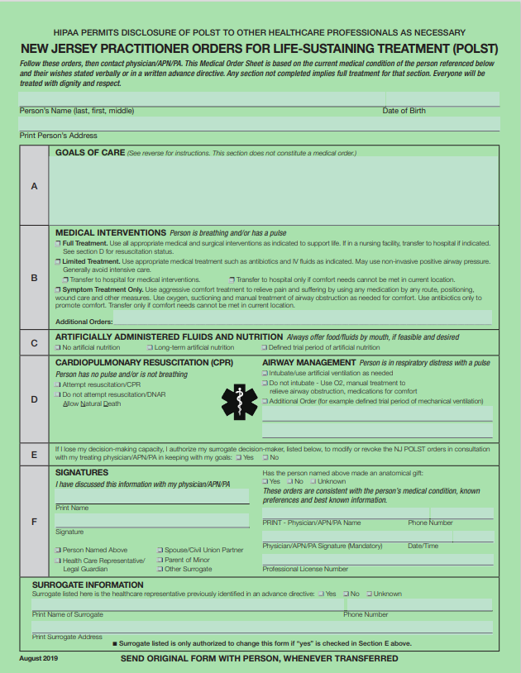
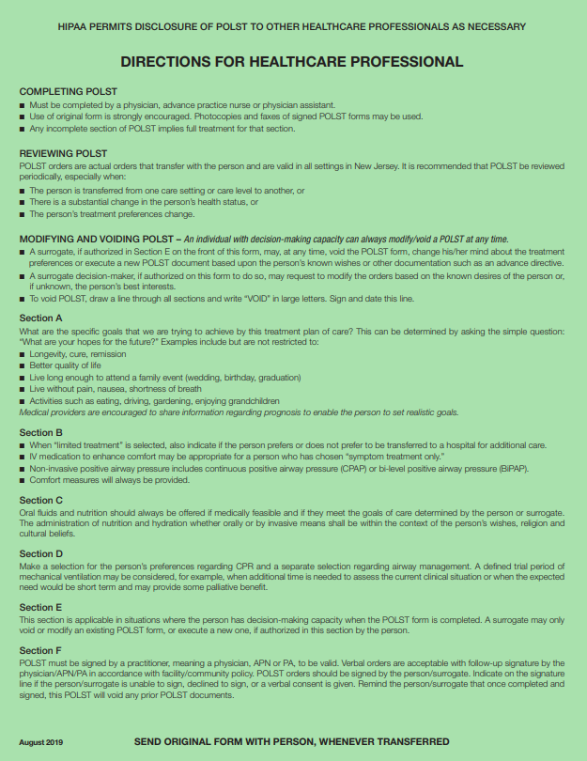
POLST Form
Notes:
This is the most recent POLST form for NJ. Different states have different color POLST forms, for NJ it is this green color.
The back has directions for completion for the healthcare professional and the front area has all the areas to be filled with the patient
We are going to take a closer look at the different sections listed that the provider would fill with the patient to reflect their wishes for life sustaining treatments.
Start with patient identifiers -name, DOB, address.

Slide 34
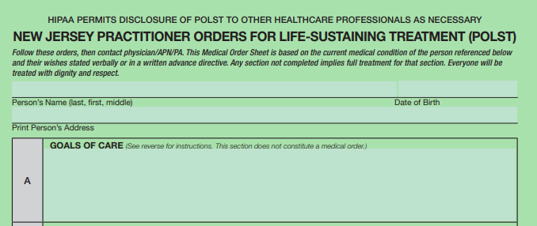
POLST Form
Notes:
Start with patient identifiers -name, DOB, address.
Section A

Slide 35

Section A- Goals of Care
Not part of the medical order set.
What is the care plan trying to achieve?
Cure, longevity, remission, comfort.
What are the hopes of the patient?

Slide 36
Section A-Goals of Care
Examples:
"Live as long as possible with freedom from pain and discomfort."
"Live long enough to attend a family event (wedding, graduation)."
Healthcare providers are encouraged to share information regarding the patient's prognosis, helping the individual to set realistic goals.

Slide 37
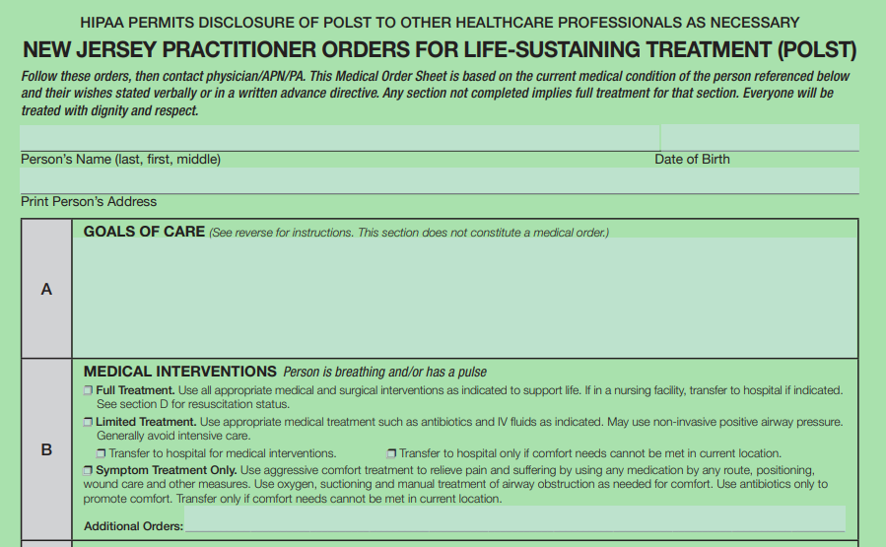
Section B-Medical Interventions
Notes:
Section B

Slide 38

Section B-Medical Interventions
Full treatment-Do EVERYTHING-no limitation on medical interventions if appropriate (e.g. ICU, intubation, dialysis... etc.)
- If in a nursing facility, transfer to hospital if indicated.
Limited Treatment-Do SOME things (e.g. antibiotics, IV fluids, non-invasive positive airway pressure).
- Generally, with limited treatment avoid intensive care.
- Need to specify your preference for transfer to hospital.
Notes:
BiPAP machine- 2 settings without an invasive tube into the lungs being placed.

Slide 39
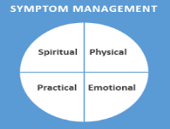
B-Medical Interventions
Symptom Treatment only – Focus on comfort (e.g. relieve pain and suffering by administration of any medication by any route, use of oxygen, airway suctioning, wound care, antibiotics for comfort only).
Transfer to hospital (only if comfort cannot be achieved in current location).
Symptom treatments include all measures to relieve not just physical suffering but also spiritual, emotional and psychological suffering.
Notes:
Use aggressive comfort treatment to relieve pain and suffering by using any medication by any route, positioning, wound care and other measures.
Use oxygen, suctioning and manual treatment of airway obstruction as needed for comfort.
Use antibiotics only to promote comfort. Transfer only if comfort needs cannot be met in current location.
Interdisciplinary team- Chaplain, Social worker, psychiatric teammates to achieve overall holistic comfort

Slide 40
Section C –Artificially Administered Fluids and Nutrition

Slide 41

Section C –Artificially Administered Fluids and Nutrition
Always offer food/fluids by mouth if feasible (safe) and desired by patient.
Artificial nutrition (tube, IV) –yes, no, or trial period.
Notes:
Trial period- defined and guided by the patient or the surrogate

Slide 42
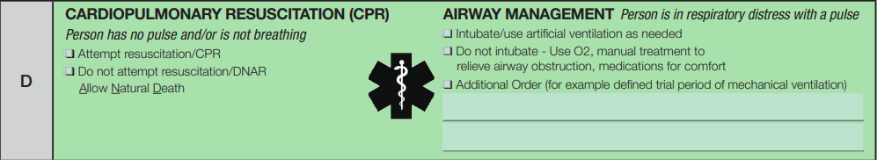
Section D- Cardiopulmonary Resuscitation (CPR) Airway Management
Person Has No Pulse and/or Is Not Breathing
Notes:
We have now reached Section D- which is where we discuss what our patient would like us to do in the case that their heart stops beating (meaning they have no pulse) or they are not breathing well

Slide 43


Section D- Left side: Cardiopulmonary Resuscitation (CPR) Person Has No Pulse and/or Is Not Breathing
Attempt resuscitation/CPR.
Do not attempt resuscitation (DNAR)/CPR- Allow Natural Death.
Notes:
Ideally an informed decision should be made after discussion with your provider about the risks associated with attempting CPR (broken ribs, aspiration, trauma...etc) as well as examine its true benefit (e.g. The American Red Cross- actually only 10 % of patients who have CPR survive to discharge, and that # decreases to <5% in the elderly and the seriously ill).
Its def. Something to keep in mind when considering the risk and benefits of attempting CPR

Slide 44
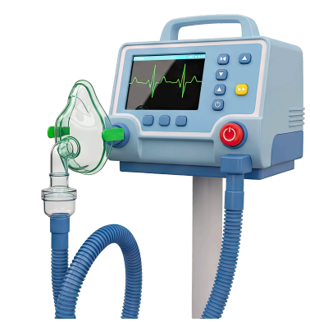
Section D- Right side: Airway Management (Person Is In Respiratory Distress With A Pulse)
Intubate/use artificial ventilation.
Do not intubate- OK to use oxygen mask/NC, non-invasive support, medications for comfort.
Defined trial period of mechanical ventilation.
Notes:
Trial period- defined and guided by the patient's surrogate
Sedated when you are intubated.

Slide 45
Section E Completed Only If Patient Has Decision Making Capacity

Slide 46
Section E Completed Only If Patient Has Decision Making Capacity
Patient’s permission for surrogate to modify or revoke the NJ POLST orders. Any modification must be in collaboration with patient’s physician/APN/PA.
Important! Avoid conflict; Ensure you are naming same designated surrogate as in healthcare proxy/representative in AD
Notes:
AD and POLST should complement each other

Slide 47
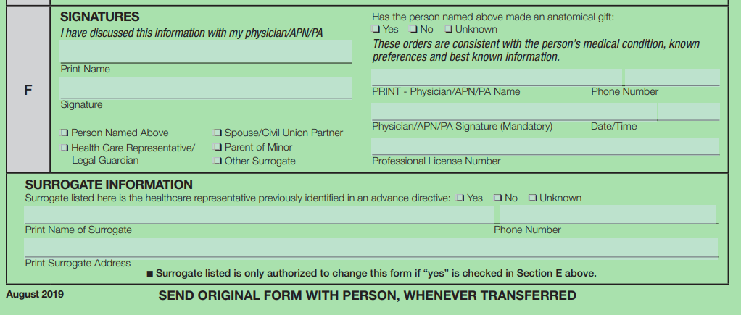
Section F-Signatures

Slide 48

Section F-Signatures
Must be signed by patient with capacity or designated surrogate decision maker for patients who lack capacity.
Physician/APN/PA must print name and license number, sign and print date and phone number.

Slide 49
NJ POLST Specifics for Providers
Always copy POLST form as two-sided to include reverse side.
Ensure there is a:
Place to print person’s name, address and date of birth.
Place to print surrogate’s name, address and phone number.
Original (GREEN) stays with patient.
Copies for medical record (two-sided-can be copied on white paper).

Slide 50
Key Points
NOTE- completing a POLST form is entirely voluntary for patients with advanced illness.
Having individual end-of-life conversations are an important and necessary part of good medical care.
Providers (Physicians/APNs/PAs) are responsible for the final clarification of patient preferences and documentation of the appropriate orders on the POLST form.
Notes:
Some Key points about POLST forms include that completing a POLST form is entirely voluntary for patients

Slide 51
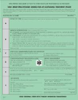
Key Points
The original POLST form on green paper, stays with the individual at all times.
If a patient is transferred to another setting, the original POLST form goes with the patient.
At home, patients should place the original form in a visible location so it can be found easily by emergency medical personnel.

Slide 52
Key Points
The POLST form can be modified/revoked by an individual with decision making capacity, verbally or in writing, at any time.
Changes can be made by the individual’s legally recognized surrogate, in collaboration with the individual’s physician/APN/PA.
It is good clinical practice to review a patient's POLST form when:
They are transferred from one medical setting to another
If there is a change in the person’s health status
With a new diagnosis
Their treatment preferences change.

Slide 53
Key Points
NOTE! Though the POLST form is a national initiative, it is state specific at this time.
To ensure that your wishes are honored if you travel between states for extended periods of time, it may be beneficial to coordinate with your local provider, (e.g. oncologist or PCP) for a state-specific POLST form.

Slide 54

Conclusion
POLST is a medical order form that empowers individuals by carefully detailing their personal healthcare wishes.
POLST translates the intentions found in an AD into an actionable order that every member of the healthcare team understands and respects.
Your quality of life during advanced illness should be totally under your control.

Slide 55
POLST
A complete listing of states using POLST:
www.POLST.org

Slide 56
Questions?
Contact us
Jack and Sheryl Morris Cancer Center
165 Somerset Street
New Brunswick, NJ 08901
(732) 235 2465
Social Work
(848) 379-4200, option 1, extension 88116
After this event, a link to a short survey will come up. Your answers will help with future events. Thank you for your time!

