Slide 1


Practitioner Orders for Life-Sustaining Treatment (POLST)
Elsie Castrorao, MSN, RN, ANP-NPC, AOCNP
Rutgers Cancer Institute of New Jersey

Slide 2

What Does “POLST” Mean?

Slide 3
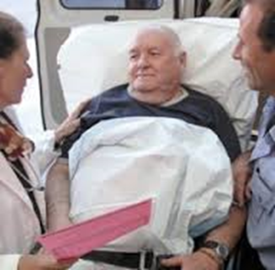
POLST
Healthcare planning tool that allow individuals to take charge of their health, by working with their medical providers to discuss their personal goals and medical preferences when facing advanced illness.

Slide 4
Differences Between Advance Directive And POLST
Advance Directives (AD) are statements of patient intention, not medical orders.
AD initiated after a patient has been determined to have lost decision-making (DM) capacity.
Statements of AD are interpreted by healthcare providers into medical orders to become active.
AD are appropriate for anyone over 18.

Slide 5
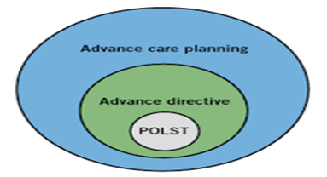
Differences
POLST is appropriate for anyone with an advanced illness.
POLST as a set of medical orders are immediately actionable/functioning-no interpretation needed.
POLST complements an AD and does not totally replace it.
Can be generated by a Physician or Advanced Practice Nurse (APN) with the patient or surrogate.

Slide 6

Why Was POLST Developed?
The goal was to provide a framework of care for healthcare professionals so they could provide the treatment patients DID want and avoid those treatments that patients DID NOT want.

Slide 7
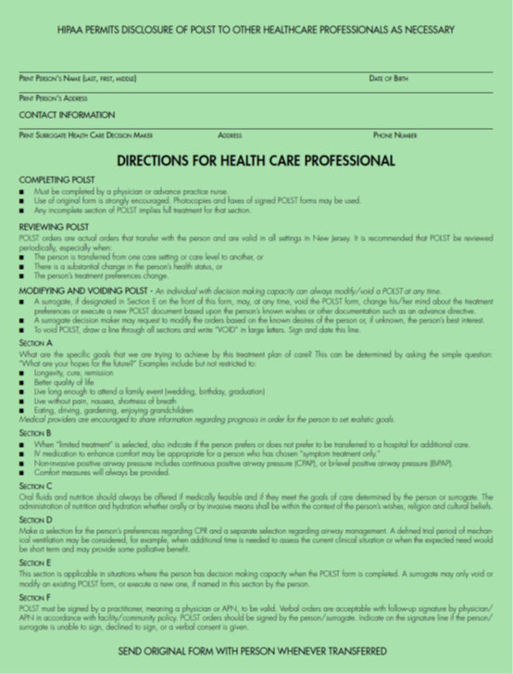
POLST Form

Slide 8

Section A-Goals of Care
Not part of the medical order set.
What is the care plan trying to achieve; cure, longevity, remission.
What are the hopes of the patient?

Slide 9
Section A-Goals of Care
Examples:
Live as long as possible with freedom from pain and discomfort.
Live long enough to attend a family event (wedding, graduation).
Healthcare providers are encouraged to share information regarding. prognosis in order for the individual to set realistic goals.

Slide 10
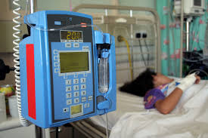
Section B-Medical Interventions
Full treatment-no limitation on medical interventions if appropriate for example; ICU, intubation.
- If in a nursing facility, transfer to hospital if indicated.
Resuscitation status - indicated in section D.
Limited Treatment-for example; antibiotics, IV fluids, non-invasive positive airway pressure.
- Generally with limited treatment avoid intensive care.
- Specify preference for transfer to hospital.

Slide 11
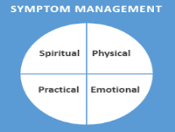
B-Medical Interventions
Symptom Treatment only – Focus on comfort (for example to relieve pain, administration of medication by any route, oxygen, suctioning, wound care).
Includes all measures to relieve spiritual, emotional and psychological suffering.
Transfer to hospital (only if comfort cannot be achieved in other settings).

Slide 12

Section C –Artificially Administered Fluids and Nutrition
Always offer food/fluids by mouth if feasible and desired by patient.
Artificial nutrition (tube, IV) –yes, no, or trial period.

Slide 13

Section D- Left side: Cardiopulmonary Resuscitation (CPR)
Person Has No Pulse and/or Is Not Breathing
Attempt resuscitation/CPR.
Do not attempt resuscitation (DNAR)/CPR- Allow Natural Death.
If you check CPR here that will require selecting full treatment in section B.

Slide 14

D- Right side: Airway Management
(Person Is In Respiratory Distress With A Pulse)
Intubate/use artificial ventilation.
Do not intubate-Use oxygen, non-invasive support, medications for comfort.
Defined trial period of mechanical ventilation.

Slide 15
Section E
Completed Only If Patient Has Decision Making Capacity
Patient’s permission for surrogate to modify or revoke the NJ POLST orders. Any modification must be in collaboration with patient’s physician/APN.
Discuss with patient any prior existence of a healthcare proxy/representative designated in an AD and avoid conflict by naming a different surrogate in this section.

Slide 16

Section F-Signatures
Must be signed by patient with capacity or designated surrogate decision maker for patients who lack capacity.
Physician/APN must print name and license number, sign and print date and phone number.

Slide 17
NJ POLST Specifics
Reverse side of POLST, always copy as two-sided.
Place to print person’s name, address and date of birth.
Place to print surrogate’s name, address and phone number.
Original (GREEN) stays with patient.
Copies for medical record (two-sided-can be copied on white paper).

Slide 18
Key Points
Filling out a POLST form is entirely voluntary for individuals with advanced illness.
Having a conversation with an individual about end-of-life issues is an important and necessary part of good medical care.
Physicians/APNs are responsible for the final clarification of those preferences and documentation of the appropriate orders on the POLST form.

Slide 19
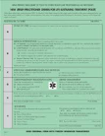
Key Points
The original POLST form on green paper, stays with the individual at all times.
If a patient is transferred to another setting, the original POLST form goes with him/her.
At home, individuals should place the original form in a visible location so it can be found easily by emergency medical personnel.

Slide 20
Key Points
The POLST form can be modified or revoked by an individual with DM capacity, verbally or in writing, at any time.
Changes can be made by the individual’s legally recognized surrogate, in collaboration with the individual’s physician/APN.
It is good clinical practice to review an individual’s POLST form when the individual is transferred from one medical setting to another, if there is a change in the person’s health status or with a new diagnosis, and/or the treatment preferences change.

Slide 21

Conclusion
POLST is a medical order form that empowers individuals by carefully detailing their personal wishes.
POLST translates the intentions found in an AD into an actionable order that every member of the healthcare team understands and respects those choices.
Your quality of life during advanced illness should be totally under your control.

Slide 22
POLST
A complete listing of states using POLST:
www.POLST.org
https://www.youtube.com/watch?v=1oelG7Rrgts

